Slide 1
Breakfast for Kids: Business Understanding
Adolescent Food and Drug Board – 2021 Recommendations

Slide 2
What Healthy Choices Look Like for Kids
• Whole grains for energy (oatmeal, whole-grain cereal, toast)
• Protein for fullness (eggs, yogurt, nut butter)
• Fruits/vegetables for vitamins (berries, bananas, smoothies)
• Healthy fats for brain growth (avocado, nuts)
• Low added sugar and minimal processed foods

Slide 3
Feasibility
• Project is answerable using nutrition data and surveys
• Scope fits available resources
• Team has technical expertise in data analysis

Slide 4
Interesting
• Helps shape national nutrition guidelines
• Supports future decisions for schools and families

Slide 5
Relevant
• Directly supports the Board’s mission
• Addresses childhood nutrition issues

Slide 6
Ethical
• Protects participant well-being
• Provides nutritional benefits to families

Slide 7
Breakfast Scenario
• Breakfast is considered crucial for health
• Board is preparing 2021 recommendations
• Role: Provide insights on breakfast healthfulness for youth

Slide 8
Problem Definition
• Kids should eat healthy breakfasts
• Families need accessible healthy options
• Units of analysis: kids, parents, food companies, schools

Slide 9
Project Objectives
• Define what 'healthy' means for kids
• Recommend healthy breakfast options
• Raise awareness among families
• Motivate kids to eat healthier
• Suggest appropriate serving sizes

Slide 10
Research Questions (Part 1)
• What foods do kids like?
– Cereal, eggs, toast, waffles, fruit, smoothies
• What does 'healthy' mean?
– Balanced nutrients, low sugar, energy support
• What does a healthy breakfast cost?
– Typically $1–$3 per serving

Slide 11
Research Questions (Part 2)
• How often do kids eat breakfast?
– Younger kids daily; teens skip more often
• How does breakfast affect energy levels?
– Improves focus, concentration, and performance
• Is breakfast the most important meal?
– For kids, it strongly supports growth and learning

Slide 12
Research Questions (Part 3)
• What are simple breakfast meals?
– Oatmeal, yogurt parfaits, smoothies, toast + fruit
• What home environments do kids come from?
– Busy, limited food access, varying nutrition knowledge
• When is the best time to eat breakfast?
– Within 1–2 hours of waking

Slide 13
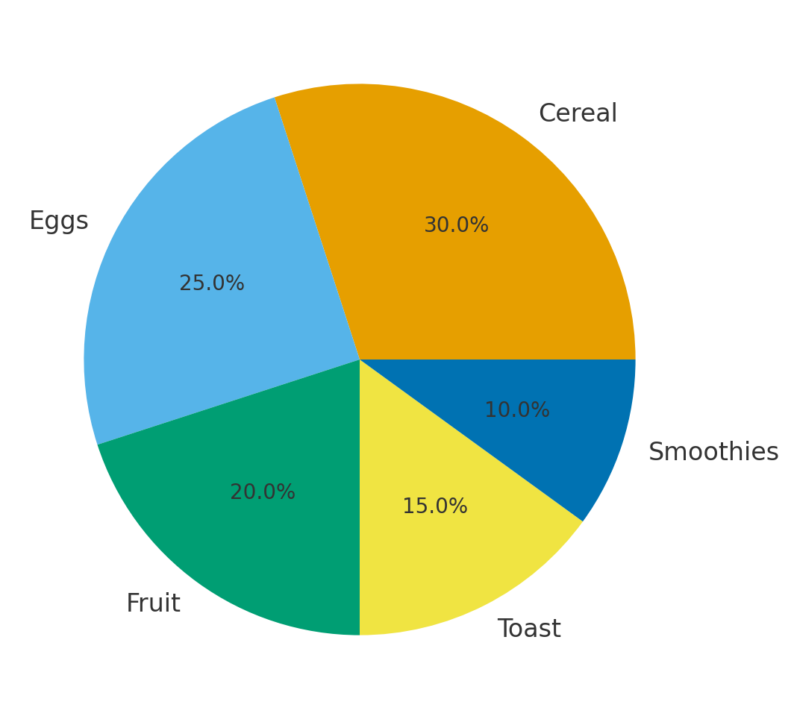
Popular Breakfast Choices Among Kids

Slide 14
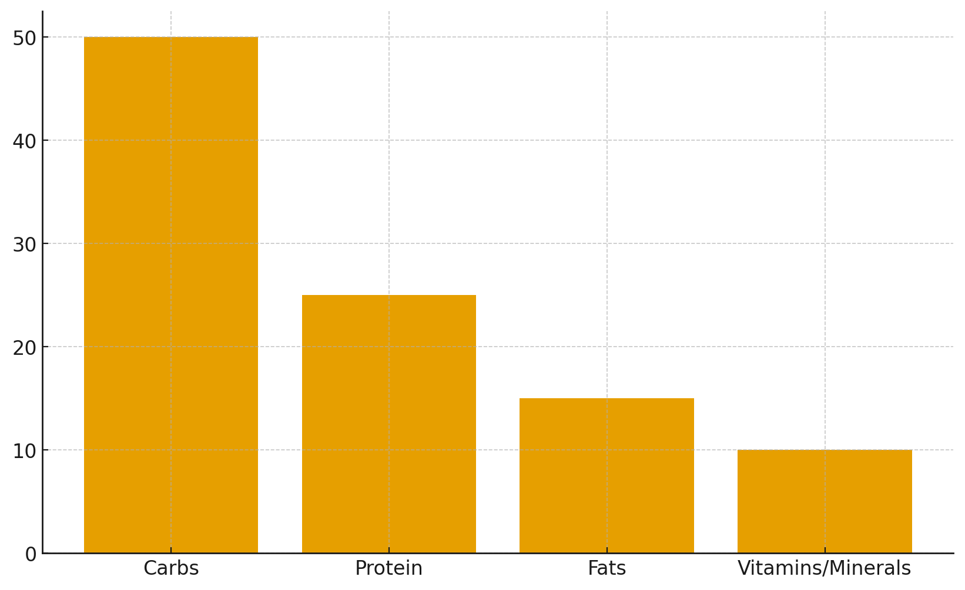
Healthy Breakfast Nutrient Breakdown

